Slide 1
Neighbor Mgmt Policy
Performance Report
- Rahul, Rabi, Simon, Joakim
IETF104, Prague

Slide 2
Updates
Text to highlight use of min-priority field in neighbor mgmt
Referenced Michael’s enrollment draft
draft-richardson-6tisch-roll-enrollment-priority
Clarifications on route cleanup and impact on neighbor cache
Performance result added

Slide 3
Performance test config
Network stack
LWIP integrated with RPL
LWIP added with neighbor mgmt policy module
Test tool
Whitefield-framework
With NS3 backend for wireless simulation
64 nodes network, 8x8 grid, 80x80 sq. mtr
802.15.4 in 2.4GHz, Unslotted CSMA with single channel
Data transmission
UDP data sent by each node at 10s interval to BR
BR echoes the packet

Slide 4
What to measure?
Packet Delivery Rate
How does neighbor management policy impact PDR?
Network convergence time
How to define network convergence time in this context?

Slide 5
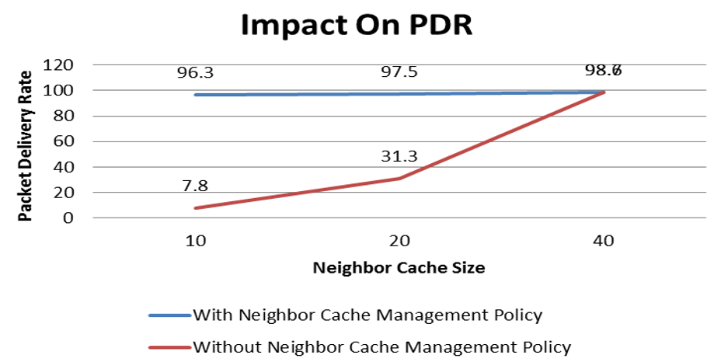
Results
PDR
>95% PDR achieved even with extremely constrained nbr-table
Network convergence time
Nbr cache size | Without NBR-mgmt | With NBR-mgmt
10 | No-convergence | 94sec
20 | No-convergence | 51sec
40 | 24sec | 25sec

Slide 6
Observations
RPL Control overhead with neighbor management was high
Because of proactive maintenance
Convergence time and control overhead is high with lower nbr cache size
Without neighbor management
The BR could get all the routes but neighbor table size was not enough
Most of the UDP traffic was dropped at BR or en-route because of next-hop unavailability in neighbor table

Slide 7
Next?
We believe the document is ready for LC

